Slide 1


Florida International University
PokerBots 2025
Lesson 1: Introduction To PokerBots & Poker

Slide 2



Thank you sponsors
GTO Wizard & Octopi Poker

Slide 3

Today’s Agenda
Competition Overview
Sam Ganzfried Guest Speaker:
Game Theory in Practice
Poker Variants
Texas Hold’em
Bot Setup
Overview of Skeleton Bot Architecture
Sample Bot #1

Slide 4

Competition Overview
Meetings Saturday 2pm - 3:30pm next 5 weeks
Must turn in weekly bot to be eligible for prizes
All Notes, PowerPoints, and Sample Code posted to FIU PokerBots Github
Office Hours, Sundays 2pm-4pm EST (In-person or Discord)
Weekly Scrimmages, weeks 2, 3, and 4, after the lecture.
Final Tournament June 14th 2pm-3:30pm

Slide 5

Team Formation
Teams of 1-4 people allowed
All majors and all levels welcome
All team members must be registered FIU students, and/or have received confirmation email
Most people should have teams, if not, let’s take a moment to find a team if you’d like one

Slide 6
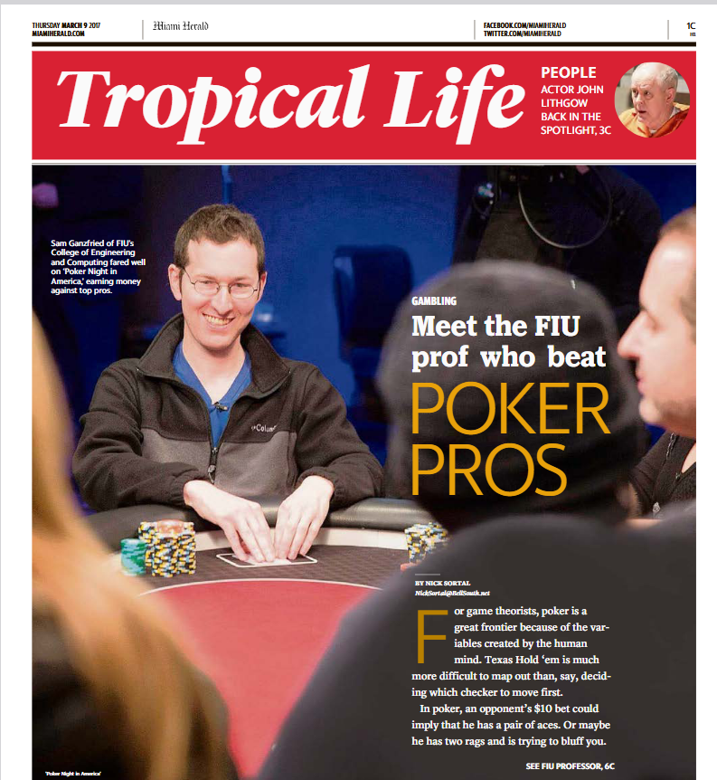
Sam Ganzfried
“Introduction to Computational
Game Theory”
Mathematician
AI & Game Theory Research
Bioinformatics Research
Poker

Slide 7
Intro to Poker - Texas Hold’em

Slide 8

No-Limit Hold’em Poker
To “win” - gain chips
To start, each player receives two cards (hole cards), only that individual can see
Multiple rounds of betting are done - Preflop, Flop, Turn, River
At the end, the pot is given to the player with the best hand
Hand strength is determined as the best 5-card poker hand you can form out of the 5 community cards on the table, and the 2 hole cards in your hand.
High vs. Low Kickers
In a betting round, the first player can bet 0 (check), or bet any amount between “big blind” and their # of chips remaining. If player1 checks, action passes to the next player, if player1 bets, the next players can fold, call, or raise

Slide 9
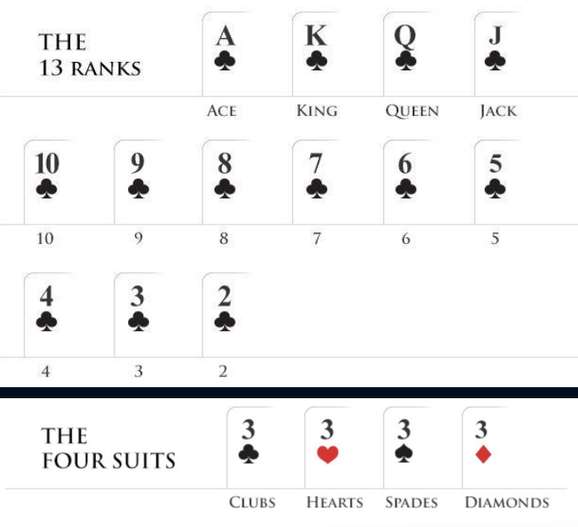
Card Rankings

Slide 10
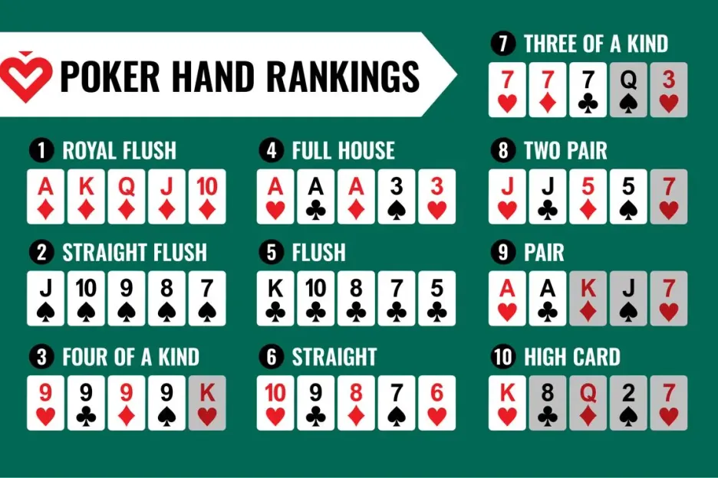

Slide 11
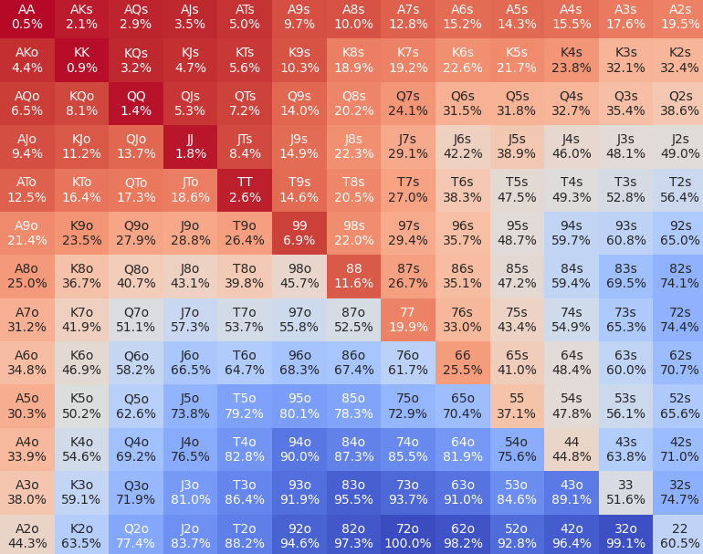
Poker Hand Strength
Pocket Pairs
Suited
Connectors
Pre-Flop Equity
“Kicker”

Slide 12

Game Variants
There are many variations of Poker, and many variations to Texas Hold’em
We will be playing Heads-Up No-Limit Texas Hold’em
Texas Hold’em is played with two cards and can be either a “limit” or “no-limit”game.
Other popular poker variants are: Pot-Limit Omaha, Omaha Hi-Lo, 7 Card Stud and Razz

Slide 13
Betting Round Structure
Pre-Flop: Each player receives two private cards (hole cards). First action is to the small blind who can fold, call, or raise. he big blind can then fold, check (if no raise), call, or raise Betting continues until all bets are equal or all but one player folds
In the subsequent rounds, the first player can bet 0 (check), or bet any amount between “big blind” and their # of chips remaining. If player1 checks, action passes to the next player, if player1 bets, the next players can fold, call, or raise

Slide 14

Betting Round Structure
Flop: Three community cards are dealt face-up on the board. First action is to the non-dealer. Players can check, bet, raise, or fold. Betting continues until all bets are equal or all but one player folds
Turn: A fourth community card is dealt face-up. Betting round proceeds same as flop
River: The fifth and final community card is dealt face-up. Final betting round proceeds same as previous streets

Slide 15
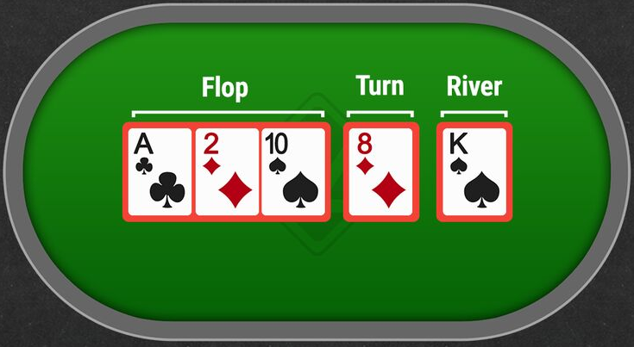
“Streets”

Slide 16
Betting Rules
Players can bet any amount from one big blind up to their entire stack
The minimum raise must be at least the size of the previous bet or raise
There is no maximum number of raises permitted
If a player doesn't have enough chips to call a bet, they can go "all-in" with their remaining chips

Slide 17
Winning the Hand
If a player folds, the remaining player wins the pot
If the players reach showdown, best five-card poker hand using any combination of hole cards and community cards wins
In case of identical hands, the pot is split

Slide 18

Local Testing
Pull engine & samples github repo
Review engine config file parameters: number of hands, number of seconds, where to bots
Run test_engine.py loaded with sample bots via config.py

Slide 19
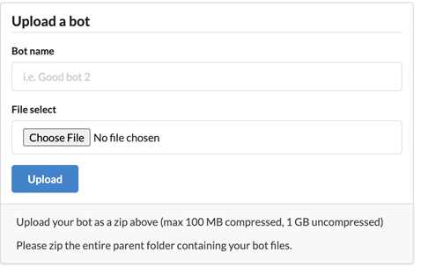
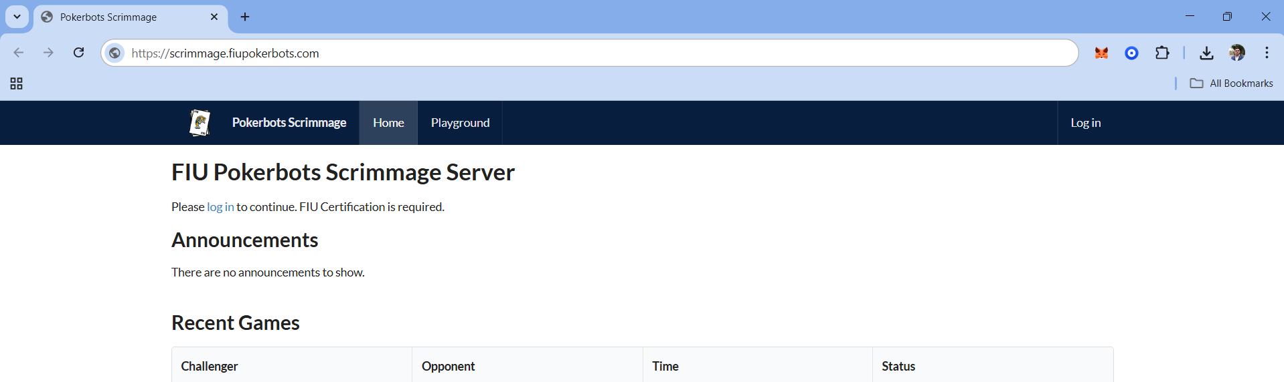
Scrimmage Server Testing
Search scrimmage.fiupokerbots.com
Sign-up/Login with FIU Credentials

Slide 20
Lesson 1 Sample Bots
ABC_Bot - player that uses simple calculations for hand strength and decision making
OpenAI_Bot - queries OpenAI API with game state and returns decision
Test them out for yourself using the test engine!

Slide 21
Overview of Skeleton Bot Architecture
Engine Structure
Test_engine.py - RoundState, Player, Game
config.py - engine and testing settings configuration
Bot Skeleton
States.py: GameState, RoundState classes
Bot.py: handle_new_round(), handle_round_over(), get_action()
Runner.py: communicates with game engine
Player.py: the main brain of the bot for decision making

Slide 22
ABC_Bot
Relies on calculating hand strength to make decisions.
In the get_action() function the bot calculates the Expected Value (EV) of each action using the formula: EV = (Probability of Winning x Pot Size) - Cost of action.
When EV > 0, the bot will raise with an amount proportional to the EV/pot_size ratio. If it can’t raise it will call, if it can’t call it will check.
When EV is negative but better than folding (EV > - cost_to_call), the bot will check, if it can’t check it will call, if not fold.
When EV is worse than folding (EV < -cost_to_call), the bot will check, otherwise fold.

Slide 23
OpenAI_Bot
Connected to OpenAI API, can be reworked to use with other LLM APIs.
Provides context to LLM about game state information and guides LLM response in returning poker actions.
get_action() creates a message with the Player’s Hole Cards, Community Cards, Stack Sizes, Current Pot Size, Cost to Call, Available Legal Actions, and Raise Limits.
The bot also maintains a conversation history with the LLM through the messages list which includes: A system message defining the LLM’s role, Game Rules and Constraints, The bot’s acknowledgement of the rules, and ongoing game state and action updates.

